Slide 1

Learn Programming For Kids (Python)

Slide 2
Lesson 7
Python Control Flow

Slide 3
10. Python Control Flow
In programming, control flow refers to the order in which the code is executed. It determines how the computer goes through different parts of the code based on certain conditions.
There are two types of control flow:

Slide 4
10.1. Conditional Statements:
Conditional statements allow the computer to make decisions based on conditions. It checks if a certain condition is true or false and executes different blocks of code accordingly.

Slide 5
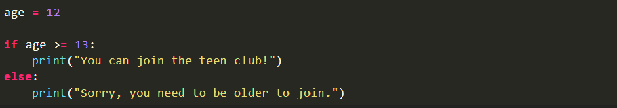
Code:

Slide 6

Output:

Slide 7
Play with Python Conditional Statements:

Slide 8
Examples:
Find maximum of two numbers in Python
Find minimum of two numbers in Python

Slide 9
10.2. Loops:
Loops allow the computer to repeat a block of code multiple times.

Slide 11
1. For loop:
It is used to repeat a block of code a specific number of times or over a collection of items.

Slide 12

Code:

Slide 13
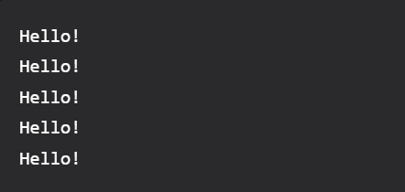
Output:

Slide 14
2. While Loop:
A while loop is used to repeat a block of code as long as a certain condition is true.

Slide 15
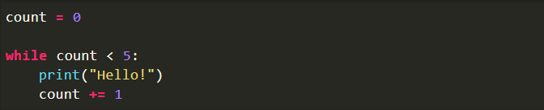
Code:

Slide 16
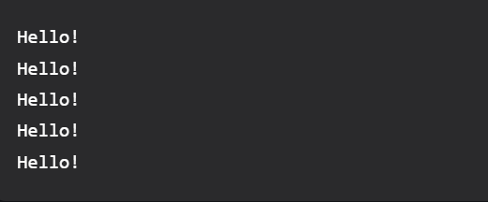
Output:

Slide 17
Play with Python Loops:

Slide 18
Examples:
Count Even and Odd numbers in a List
Print negative numbers in a list

